Slide 1
Empowering Financial Security Detecting Fraudulent Transactions using Advanced Machine Learning Techniques and Predictive Analytics

Slide 2
Introduction
In this project, we aim to safeguard financial well-being by leveraging advanced machine learning techniques and predictive analytics to detect fraudulent transactions.
Fraud detection is paramount for financial institutions and businesses to protect assets, maintain trust, and ensure secure financial ecosystems.
It is a critical aspect of the financial industry, particularly in the realm of online transactions. With the increasing threat of fraud in digital payments, the need for robust and effective fraud detection systems has never been more pressing.

Slide 3
Problem Statement
Develop a machine learning model to detect potentially fraudulent transactions based on the provided features. The dataset contains information about various transactions, including account age, payment method, time of transaction, and category. The goal is to build a classification model that can accurately classify transactions as either legitimate or potentially fraudulent.

Slide 4
Project Journey
1. Understanding the Data
2. Data Pre Processing
3. Feature Engineering
4. Model Selection
5. Model Training
6. Model Evaluation

Slide 5
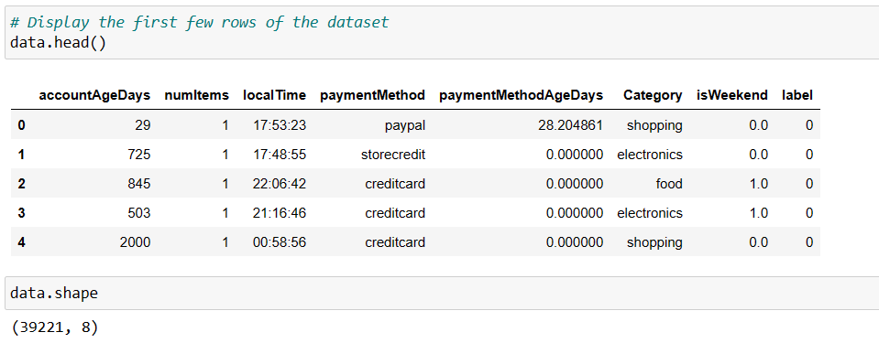
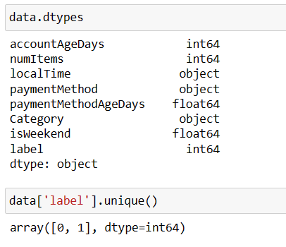
Project Journey
1. Understanding the Data
2. Data Pre Processing
3. Feature Engineering
4. Model Selection
5. Model Training
6. Model Evaluation
Key features include account age, payment method, time of transaction, and category.
The 'label' indicates whether a transaction is fraudulent(1) or legitimate(0).

Slide 6
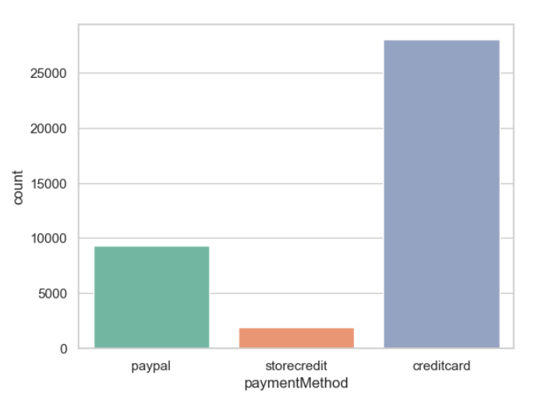
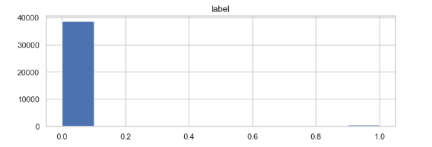
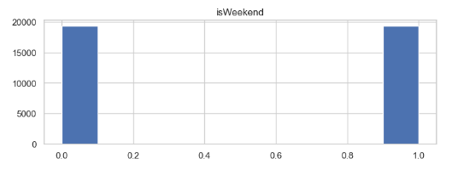
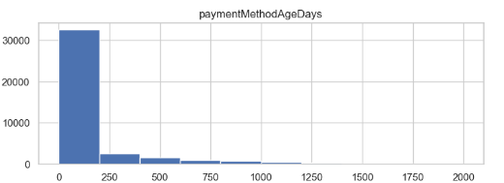
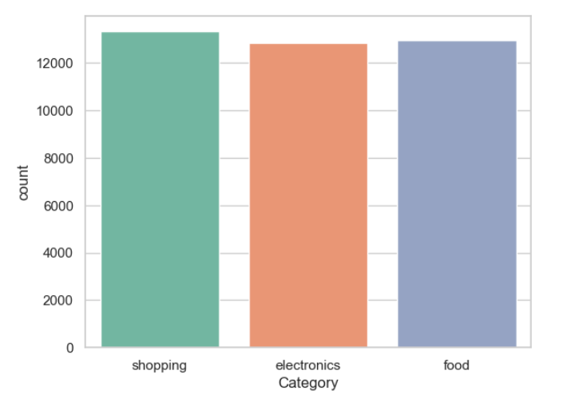
Project Journey
1. Understanding the Data
2. Data Pre Processing
3. Feature Engineering
4. Model Selection
5. Model Training
6. Model Evaluation

Slide 7
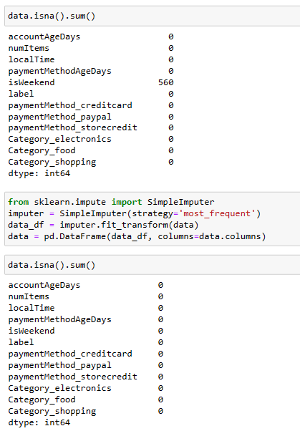
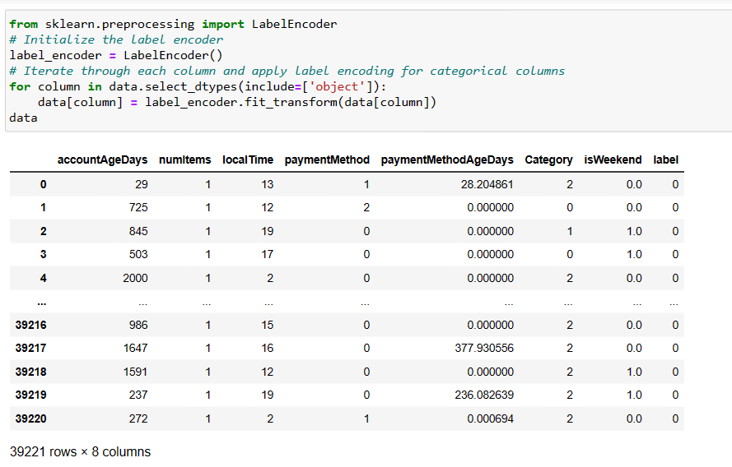
1. Understanding the Data
2. Data Pre Processing
3. Feature Engineering
4. Model Selection
5. Model Training
6. Model Evaluation
We cleaned and prepared the dataset for analysis.
Any missing data points were addressed to ensure data integrity.
Categorical variables were transformed into numerical format for machine learning.

Slide 8
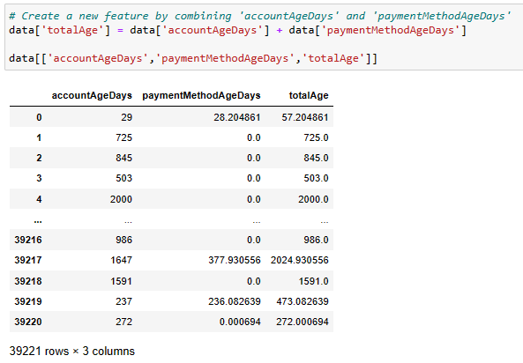
1. Understanding the Data
2. Data Pre Processing
3. Feature Engineering
5. Model Training
6. Model Evaluation
4. Model Selection
We applied feature engineering techniques to improve the model's performance.
Certain features were transformed or combined to extract more valuable information.

Slide 9
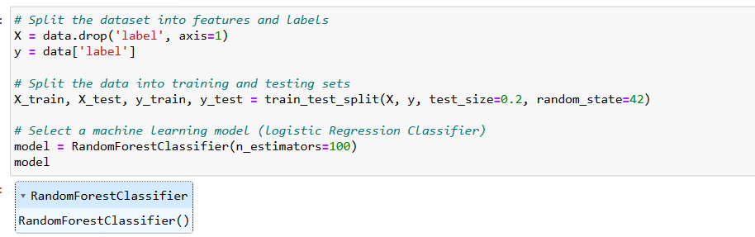
1. Understanding the Data
2. Data Pre Processing
3. Feature Engineering
4. Model Selection
5. Model Training
6. Model Evaluation
The Random Forest algorithm is a popular choice for classification tasks due to its ability to handle complex datasets and provide accurate predictions.

Slide 10

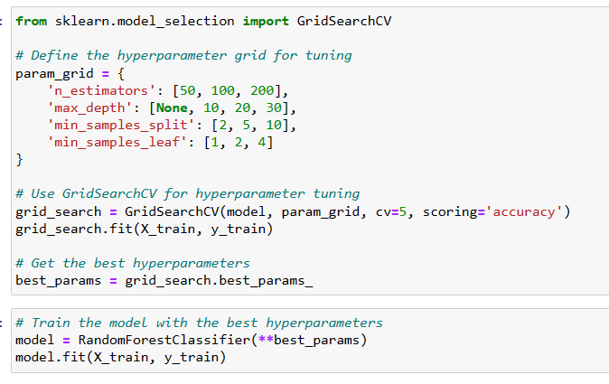
1. Understanding the Data
2. Data Pre Processing
3. Feature Engineering
4. Model Selection
5. Model Training
6. Model Evaluation
The model was trained using our preprocessed dataset.
Specific hyperparameters were tuned to optimize model performance.

Slide 11
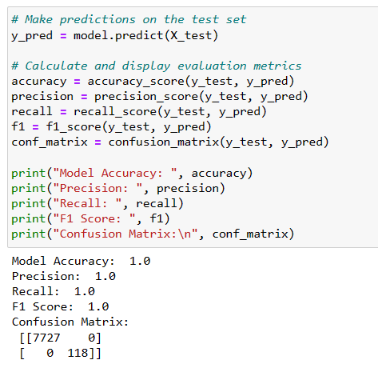
Project Journey
1. Understanding the Data
2. Data Pre Processing
3. Feature Engineering
4. Model Selection
5. Model Training
6. Model Evaluation
We evaluated the model using a range of performance metrics, including accuracy, precision, recall, F1-score, and AUC.

Slide 12
Conclusion
In this payment fraud detection project, we followed a structured approach that encompassed understanding the data, preprocessing it, engineering features, selecting a suitable model, training it, and rigorously evaluating its performance.
The model achieved a 100% accuracy in identifying payment fraud. The model's performance results show a sign of some error, like overfitting; that is, the model learns the characteristics of the training set so specifically that it cannot generalize to unseen data in the validation and evaluation sets.

Slide 13
T H A N K Y O U
Presentation By -
Navya Dua

